Slide 1
How to set up a server
Ubuntu 12.04 LTS (Precise Pangolin)

Slide 2
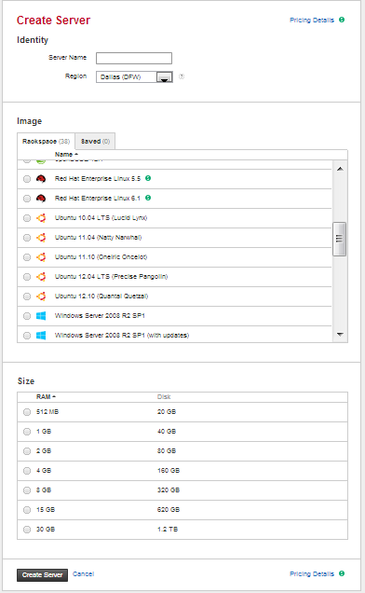
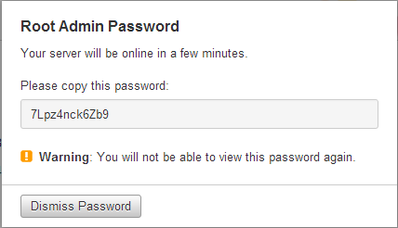
Create a server
Server name
ex. myserver
Region
Dallas (DFW)
Image
Select “Ubuntu 12.04 LTS (Precise Pangolin)
Size
Select 512 MB
Copy the password
ex .7Lpz4nck6Zb9

Slide 3
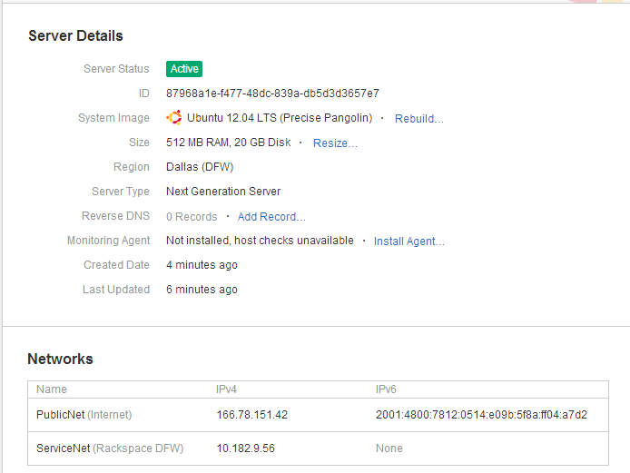
Server Details
IP Address

Slide 4
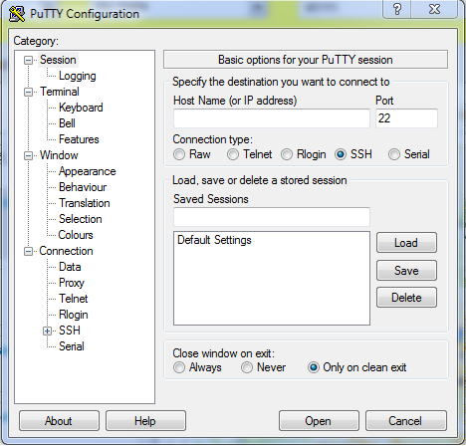
Putty
You can download Putty in http://the.earth.li/~sgtatham/putty/latest/x86/putty.exe
Put the IP address here
ex. 166.78.151.42
Port should be 22

Slide 5
Essential Commands
Use “sudo” when accessing with root privileges
Use “sudo -i” to go back to root user
Use “sudo nano” to edit or create a file
Use “ctrl + o” then “Enter” to save file
Use “ctrl + x” to exit
Use “ctrl + w” to find text in a file
Use “ctrl + c” to cancel execution
Use “mkdir” to create a folder
Note: Universal password used all over the test server: “mypassword”

Slide 6
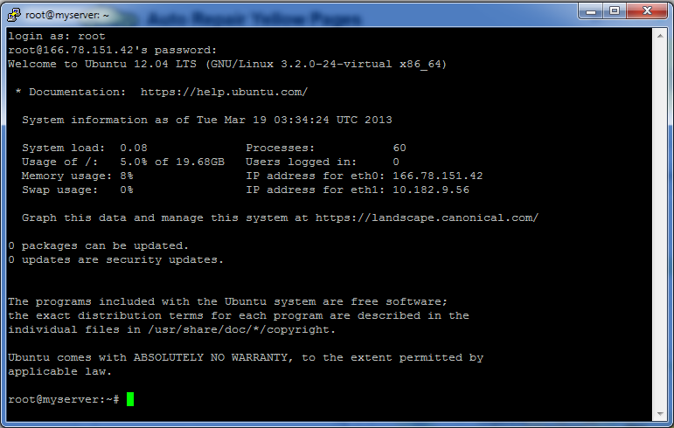
SSH Shell
Password given after creating a server
ex. 7Lpz4nck6Zb9

Slide 7
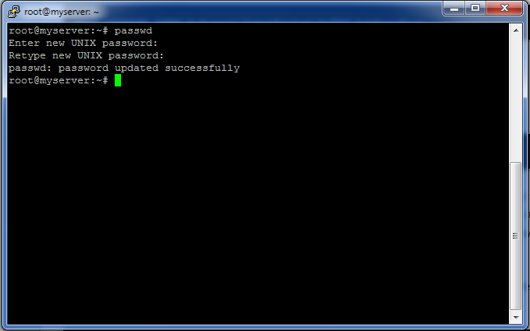
Change password
Type “passwd” then type your new password
Password given after creating a server
ex. 7Lpz4nck6Zb9

Slide 8
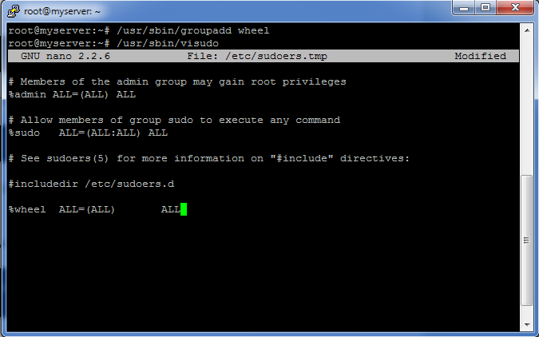
Add a group
Password given after creating a server
ex. 7Lpz4nck6Zb9
Add “%wheel ALL=(ALL) ALL”
Use “ctrl + o” then hit “Enter” to save
Use ”ctrl + x” to exit

Slide 9
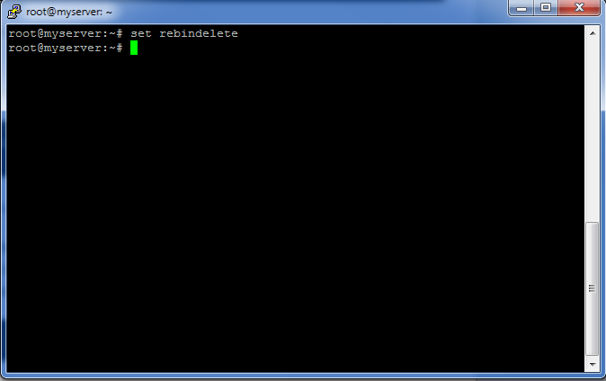
Set the rebindelete
Password given after creating a server
ex. 7Lpz4nck6Zb9
NOTE: Some users will find that while working in the nano editor, the backspace/delete key works backwards, deleting characters in front of the cursor rather than behind it. This can be resolved by editing the '/etc/nanorc' file (with nano, for example) and either uncommenting or adding the line:
set rebindelete

Slide 10
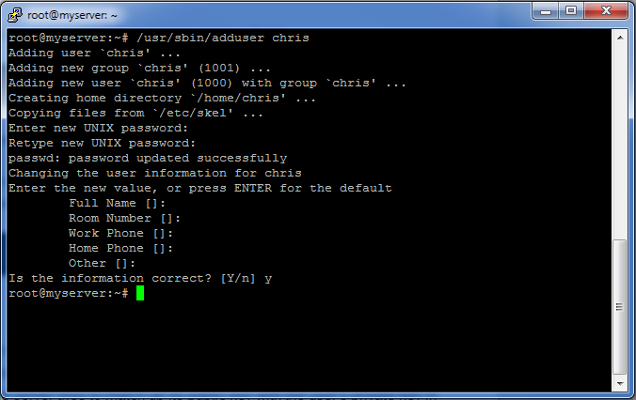
Add new user
Add user by typing “/usr/sbin/adduser chris”
Enter password for the user
Entering Full name, Room number, etc is optional

Slide 11
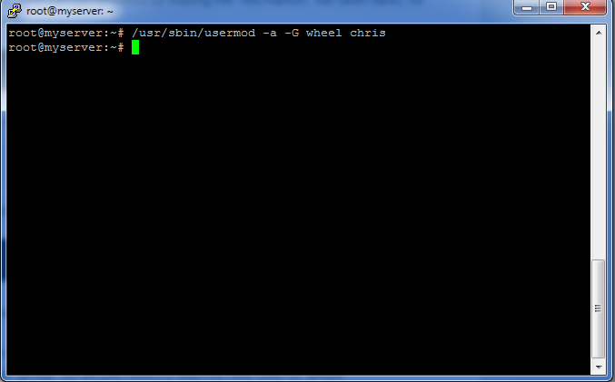
Add user in a group
Add user “chris” to group “wheel” just type “/usr/sbin/usermod -a -G wheel demo”
Note: Do the same if you want to add additional users

Slide 12
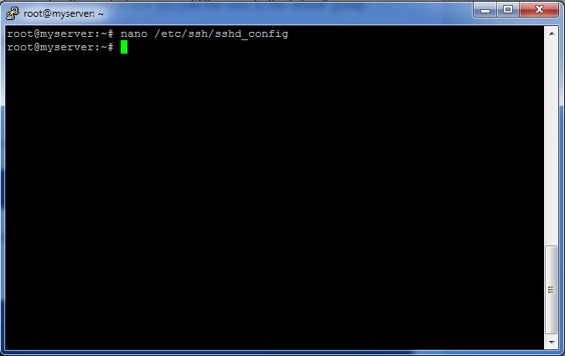
Sshd Configuration
Enter “nano /etc/ssh/sshd_config” to configure
Change
Port 31000 <--- change to a port of your choosing
Protocol 2
PermitRootLogin no
PasswordAuthentication no
UseDNS no
AllowUsers chris <--- depends on what user you named
Note when using ufw (aside from iptables):
If you change the default port from 22 to 31000 (or any number), make sure you also run
sudo ufw allow 31000/tcp (replace 31000 to the number you specified as port).

Slide 13
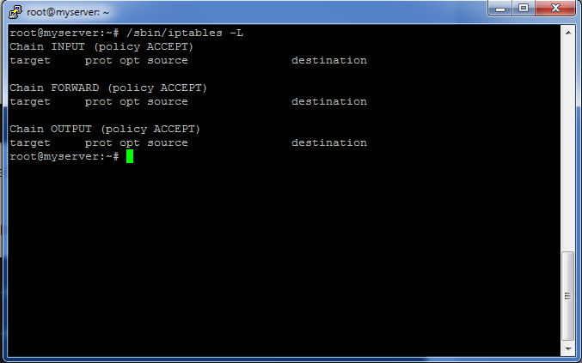
Iptables
Type “/sbin/iptables –L” to show default iptables rules

Slide 14
Add Iptables to enable ports
Type /sbin/iptables -F
Add iptables.up.rules by typing “nano /etc/iptables.up.rules”
Add this sample text then change the port in what you have changed in the sshd config “-A INPUT -p tcp -m state --state NEW --dport 31000 -j ACCEPT”
Type “/sbin/iptables-restore < /etc/iptables.up.rules” to implement the changes
Type “/sbin/iptables –L” to check the changes
Note: Use “sudo” if not using root access
ex. “sudo nano /etc/iptables.up.rules”

Slide 15
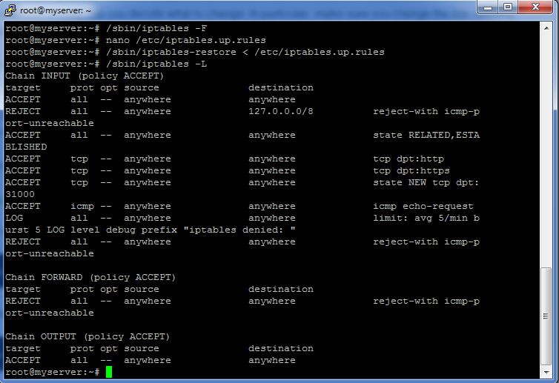
Iptables configuration

Slide 16
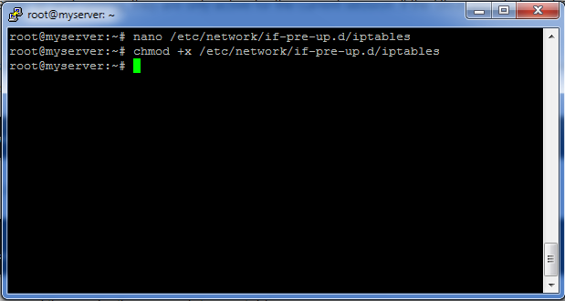
How to restore iptables on a Slice reboot
Although the rules are up and running, they are only active for the current session. If the Slice were to be rebooted they would be lost.
As such, let's ensure they are restored on a Slice reboot. We'll add a small script that the system will run when your network interfaces are started. Create the file by running: “nano /etc/network/if-pre-up.d/iptables”
Then save the changes by typing “chmod +x /etc/network/if-pre-up.d/iptables”
Note: If later changing any in iptables do this process again
nano /etc/iptables.up.rules
/sbin/iptables -F
/sbin/iptables-restore < /etc/iptables.up.rules

Slide 17
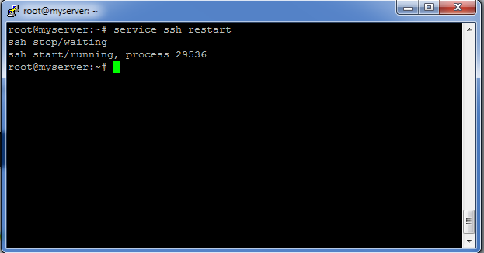
Restart ssh to apply the changes
Reload ssh by typing “service ssh restart”

Slide 18
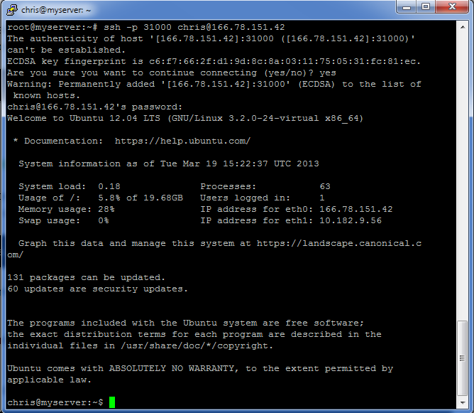
Login as user
To login as “chris” type “ssh -p 31000 chris@166.78.151.42”
Type “yes” for authenticity
Type users password

Slide 19
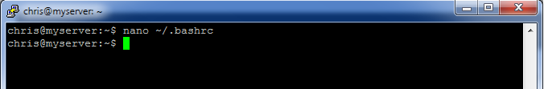
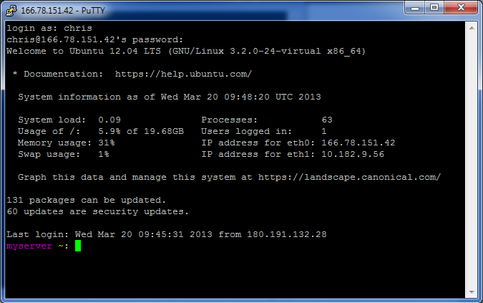
Custom prompt
Type “nano ~/.bashrc”
Add “ PS1='\[\033[0;35m\]\h\[\033[0;33m\] \w\[\033[00m\]: ‘ ” in the file
To activate the changes you've made to the .bashrc file, either log out and log back in or enter this command: “source ~/.bashrc”

Slide 20
Install Packages
Update the server by typing “sudo aptitude update” then wait for it to finish
To see if there are any upgraded packages available by typing “sudo aptitude safe-upgrade” and type “y”
Select “keep the local version currently installed”
So instead of installing a dozen different package names, you can install just one meta-package. One such package is called 'build-essential'. Type “sudo aptitude install build-essential” and type “y” then wait for it to finish.

Slide 21
Installing MySQL
Run “sudo aptitude update” first
Install the MySQL by running “sudo aptitude install mysql-server”
Type “y” to continue with the installation
You will be asked for a new password for the root user in MySQL.
Add this lines in the iptables (go back to slide 14 and 15 for reference to add permission)
Note: Remember to use “sudo” because we are not using root user
-I INPUT -p tcp --dport 3306 -m state --state NEW,ESTABLISHED -j ACCEPT
-I OUTPUT -p tcp --sport 3306 -m state --state ESTABLISHED -j ACCEPT
Type “sudo service mysql start” to start mysql
This should also have been done for you at install time to make mysql launch at boot, but just in case type “sudo /usr/sbin/update-rc.d mysql defaults”
To open mysql using root user type “sudo /usr/bin/mysql -u root –p”
You will be greeted by “mysql>”
To change password use “UPDATE mysql.user SET Password = PASSWORD('password') WHERE User = 'root';”
To make change go into effect type ” FLUSH PRIVILEGES;”

Slide 22
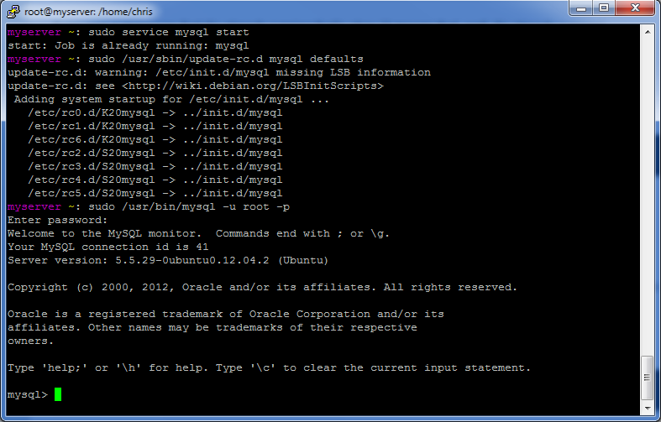
Installing MySQL cont . . .

Slide 23
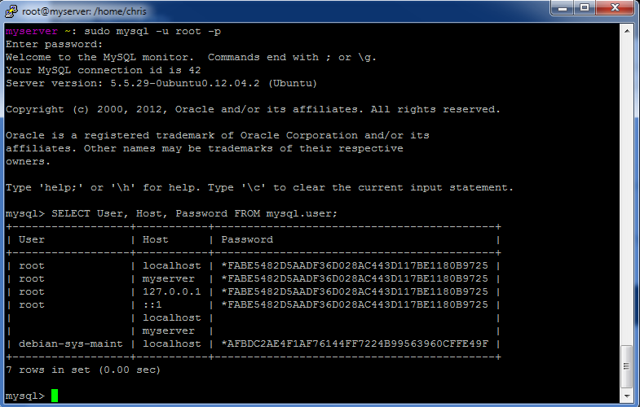
Installing MySQL cont . . .
If you want to see what users are set up in MySQL type either
mysql> SELECT User, Host, Password FROM mysql.user; or
mysql> SELECT User, Host, Password
-> FROM mysql.user;
(break lines up into smaller parts to make them easier to read)

Slide 24
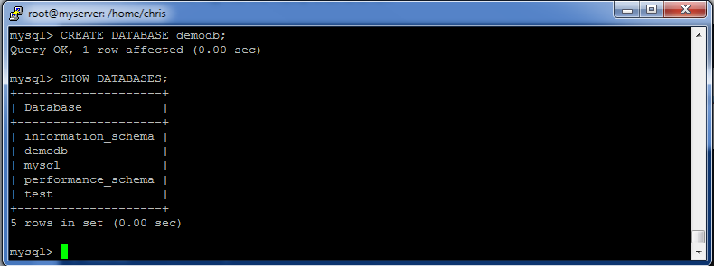
Create Database
Type “CREATE DATABASE demodb;”
To show databases type “SHOW DATABASES;”

Slide 25
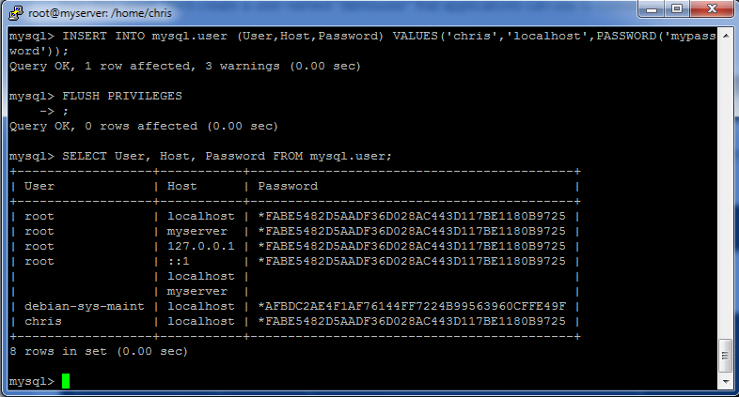
Add a database user
Use “INSERT INTO mysql.user (User,Host,Password) VALUES('chris','localhost',PASSWORD('mypassword'));”
Type “FLUSH PRIVILEGES;” to apply changes
To show the users type “SELECT User, Host, Password FROM mysql.user;”

Slide 26
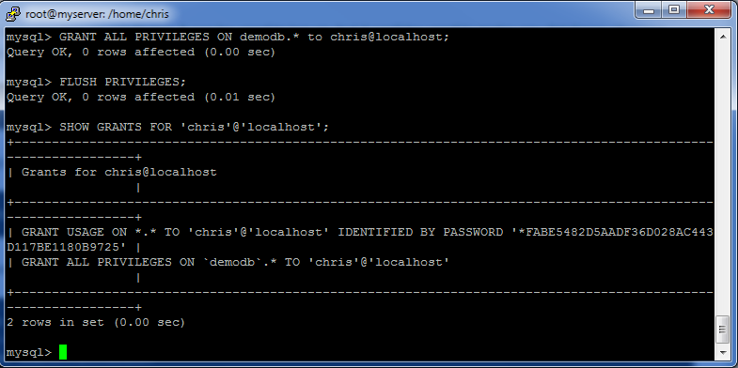
Grant database user permissions
To grant privileges type “GRANT ALL PRIVILEGES ON demodb.* to chris@localhost;”
Type “FLUSH PRIVILEGES;” to apply changes
To show grants of a user “SHOW GRANTS FOR 'demouser'@'localhost';”

Slide 27
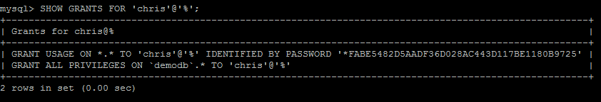
Grant database user permissions (remote access)
Use “INSERT INTO mysql.user (User,Host,Password) VALUES('chris', '%',PASSWORD('mypassword'));”
Type “FLUSH PRIVILEGES;” to apply changes
To grant privileges type “GRANT ALL PRIVILEGES ON demodb.* to 'chris'@'%';”
Type “FLUSH PRIVILEGES;” to apply changes
To show grants of a user “SHOW GRANTS FOR 'demouser'@'%';”
Then type “exit” to exit.

Slide 28
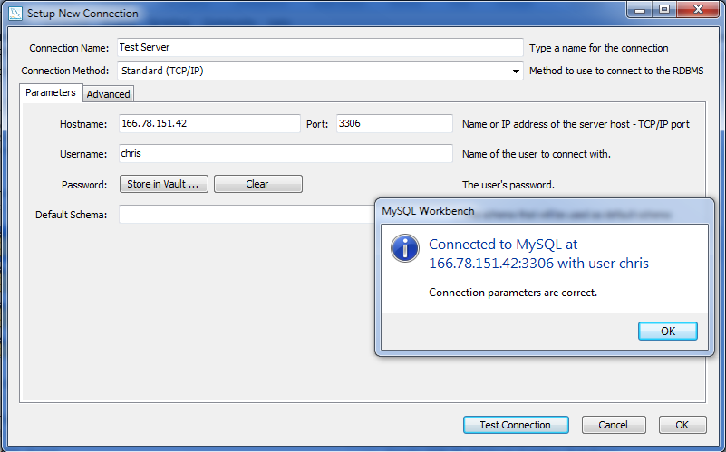
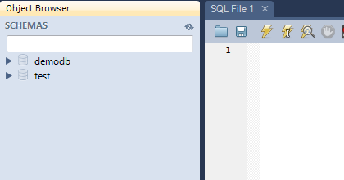
Grant database user permissions (remote access) cont . . .
Open my.cnf file by typing “sudo nano /etc/mysql/my.cnf”
Change the bind using your ipaddress then save
Ex. bind-address = 166.78.151.42
Restart MySQL by invoking “sudo service mysql restart”
Use your MySQL Workbench and fill in the needed fields to check if the connection is working . “Use Test Connection” first to check
You can download MySQL Workbench in http://dev.mysql.com/downloads/workbench/

Slide 29
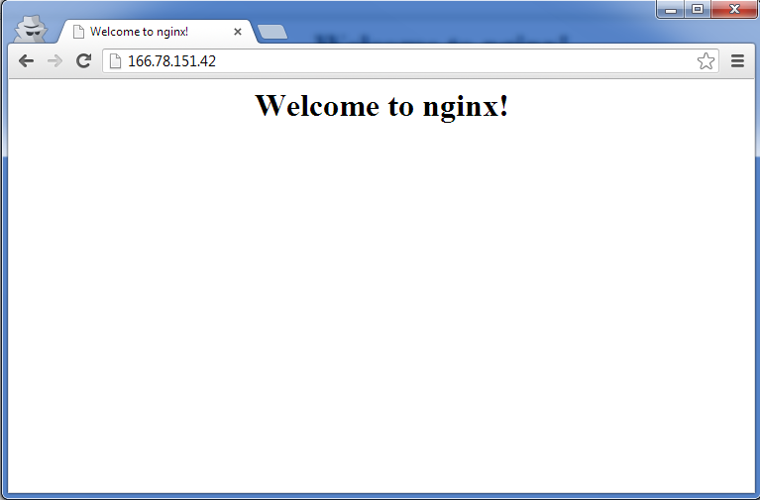
Installing Nginx
Type “sudo apt-get install nginx” to install nginx
Type “y” to continue
Start nginx by typing “sudo service nginx start”
On your browser, enter your IP address and you will get below image view

Slide 30
Installing php5 fpm
Type “sudo apt-get install php5-fpm” to install php5 fpm
Type “y” to continue
Configure nginx.conf by typing “sudo nano /etc/nginx/nginx.conf”
Change “worker_processes” to 4 and “keepalive_timeout” to 2 then save
Type “sudo /etc/nginx/sites-available/default” to configure and refer to this text
Restart nginx by typing “sudo service nginx stop” then “sudo service nginx start”
Add a file in the www folder to check php by typing “sudo nano /usr/share/nginx/www/info.php” then add this php line
<?php phpinfo(); ?>

Slide 31
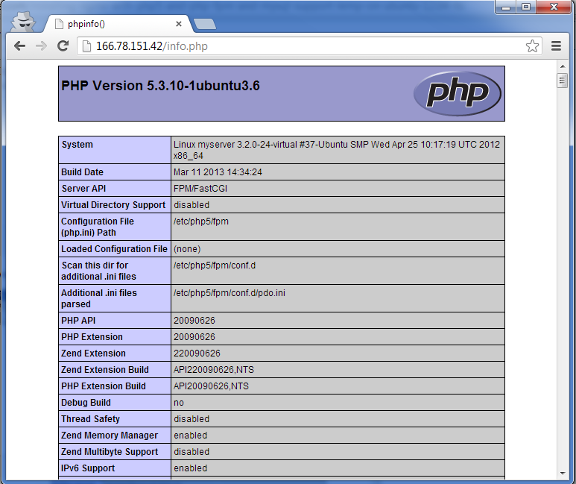
Installing php5 fpm cont . . .
Check your page in your browser by accessing “http://youripaddress/info.php
ex. http://166.78.151.42/info.php

Slide 32

Installing php5 fpm cont . . .
Check the php modules you need by typing “apt-cache search php5”
Example of installing module:
apt-get install php5-mysql php5-curl php5-gd php5-intl php-pear php5-imagick php5-imap php5-mcrypt php5-memcache php5-ming php5-ps php5-pspell php5-recode php5-snmp php5-sqlite php5-tidy php5-xmlrpc php5-xsl
Restart php after installation by invoking “sudo service php5-fpm restart”
Check the test server in http://166.78.151.42/info.php

Slide 33
References
http://articles.slicehost.com/2010/4/30/ubuntu-lucid-setup-part-1
http://articles.slicehost.com/2010/4/30/ubuntu-lucid-setup-part-2
http://articles.slicehost.com/2011/3/10/installing-mysql-server-on-ubuntu
http://www.howtoforge.com/installing-nginx-with-php5-and-php-fpm-and-mysql-support-lemp-on-ubuntu-12.04-lts

Slide 34
“Never think you can’t!” fin

